Slide 1
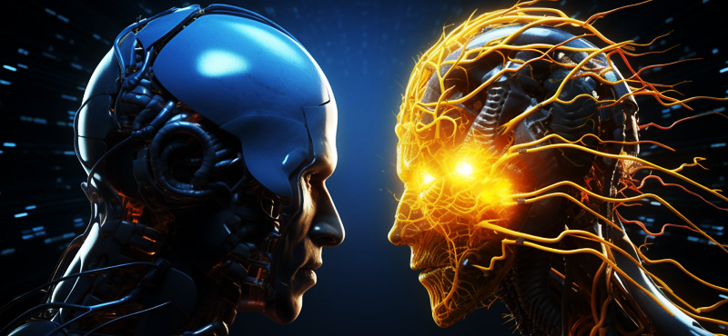
Traditional AI vs Generative AI
A comparative exploration of AI types and their applications

Slide 2
Table of Contents
Definitions
?
?

Slide 3
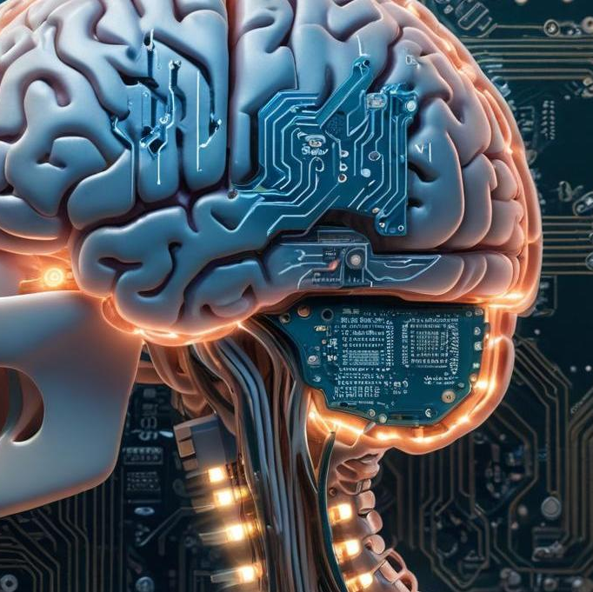
What is AI?
Artificial Intelligence (AI) refers to the simulation of human intelligence in machines that are designed to think and act like humans. This includes tasks such as learning, reasoning, problem-solving, and understanding natural language.

Slide 4
Traditional AI
Rule-based systems and programmed algorithms designed to solve specific problems.
It involves pre-defined tasks and relies heavily on human expertise for its operations.

Slide 5
Key historical milestones
Significant milestones in Traditional AI include the Turing Test (1950), the creation of early neural networks (1960s), and advancements in natural language processing (1990s). These milestones have laid the foundation for current AI capabilities.

Slide 6

Common models
Some well-known Traditional AI models include expert systems like MYCIN, decision tree algorithms, and rule-based systems. These models were instrumental in domains like medical diagnosis and industrial automation.

Slide 7
03
Building Traditional AI

Slide 8
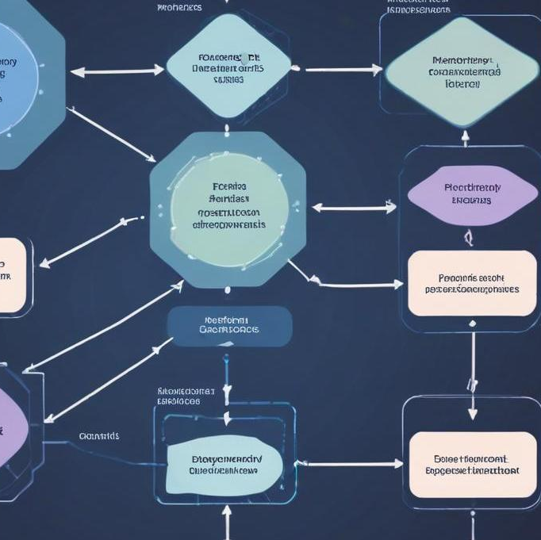
Model development process
The model development process for Traditional AI involves data collection, preprocessing, selecting the appropriate algorithms, training the model, testing its performance, and deploying the system. Each step is critical to ensuring the model's relevance and accuracy in real-world applications.

Slide 9
Algorithms and learning types
Common algorithms used in Traditional AI include decision trees, support vector machines, and neural networks. Learning types can be classified into supervised learning, unsupervised learning, and reinforcement learning, each suitable for different problems and datasets.

Slide 10
Example: Creating a Traditional AI model
To create a Traditional AI model, one might start with defining the problem, gather relevant data, clean and preprocess that data, choose a suitable algorithm (e.g., decision tree), train the model, validate its accuracy, and finally deploy it for use, alongside monitoring its performance.

Slide 11
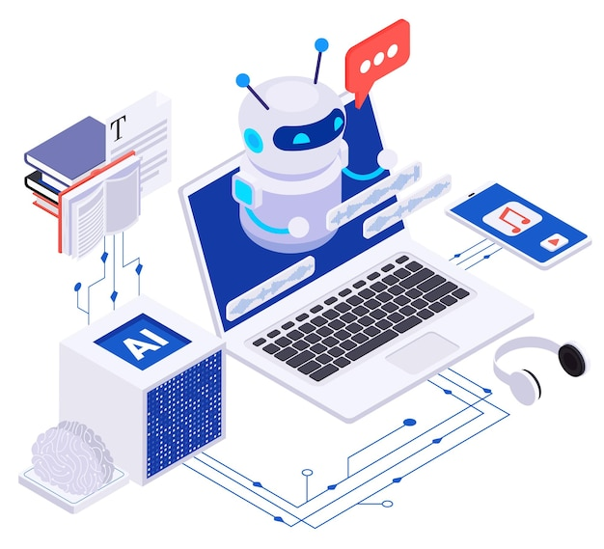
04
Generative AI

Slide 12

Definition and use cases
Generative AI is a type of artificial intelligence that focuses on creating new content, including text, images, music, and videos. Its applications range from content creation for marketing, art, and entertainment to enhancing simulation environments in industries like gaming and training.

Slide 13
Key historical milestones
Important milestones in Generative AI include the development of Generative Adversarial Networks (GANs) in 2014, the introduction of styles in AI-generated art, and recent advancements in natural language processing models like GPT. These milestones have significantly impacted how we generate content today.

Slide 14
Common Generative AI models
Some widely recognized Generative AI models include DALL-E for image generation, GPT-3 for text generation, and music generation models like OpenAI's MuseNet. These models utilize complex algorithms to understand context and produce relevant and creative outputs.

Slide 15
05
Building Generative AI

Slide 16
Model development process
The development process for Generative AI models typically involves defining the target outputs, collecting diverse datasets, training neural networks using user-defined parameters, validating output quality, and finally deploying the model for public or private use, along with continuous adjustments based on feedback.

Slide 17

Algorithms and learning types
Key algorithms for Generative AI include GANs, variational autoencoders (VAEs), and autoregressive models. These use generative learning principles to create new data samples from learned distributions, allowing for flexible content generation across various formats.

Slide 18
Example: Creating a Generative AI model
Creating a Generative AI model might involve identifying the type of content desired (e.g., images), assembling a representative dataset, choosing a model architecture (such as GANs), training the model on the dataset, and refining the generator based on output quality and user feedback.

Slide 19
Conclusions
The presentation has explored the distinctions between Traditional AI and Generative AI, highlighting definitions, historical milestones, model building processes, and the variety of algorithms used. Understanding these aspects is essential for leveraging AI technologies effectively in diverse applications.

Slide 20
Thank you!
Do you have any questions?
+91 620 421 838

